Slide 1

Speak fluently
Intermediate

Slide 2
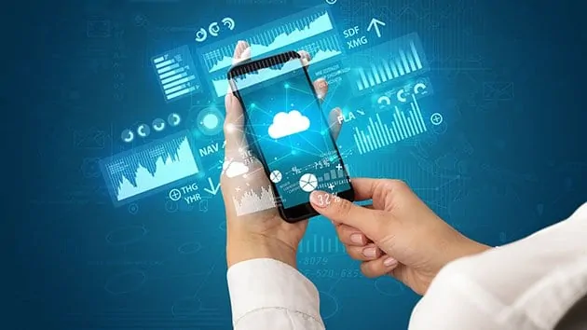
16. Smart Phones

Slide 3
16. Smart Phones
Explain how smart phones have changed our lives?
Smart and mobile phones are not to be taken into exams. What do you think of this school rule?
Do you have a smartphone?
In your opinion, which company makes the best smartphones?
What is the biggest benefit to owning a smartphone?
What is the biggest danger that comes from owning a smartphone?
How long do you spend every day looking at your smartphone?
Aside from making calls, what do you use your smartphone for?
How old should a child be before they receive a smartphone?
Should smartphones be banned from schools?
Can smartphones be used in education? In what way?

Slide 4
16. Smart Phones
11. Have you ever used an e-ticket on your phone for any purpose? Did it work?
12. Do you ever pay for things using a smartphone? Are you comfortable with this?
13. What is the most interesting app you have ever used on a smartphone?
14. Do you find it worrying that your smartphone tracks your location?
15. Do you worry that someone could spy on you through your smartphone camera?
16. Does owning a smartphone mean less private time?
17. How do you feel when a friend or relative looks at their phone while speaking to you?
18 Does it irritate you when you see people staring at their phones in the street?
19. Do you think smartphones will get bigger or smaller in future?
20. What do you think smartphones will be able to do in ten years' time?
21. Will smartphones still be popular in fifty years?
22. In general, do you think that smartphones have been good for society?

Slide 5
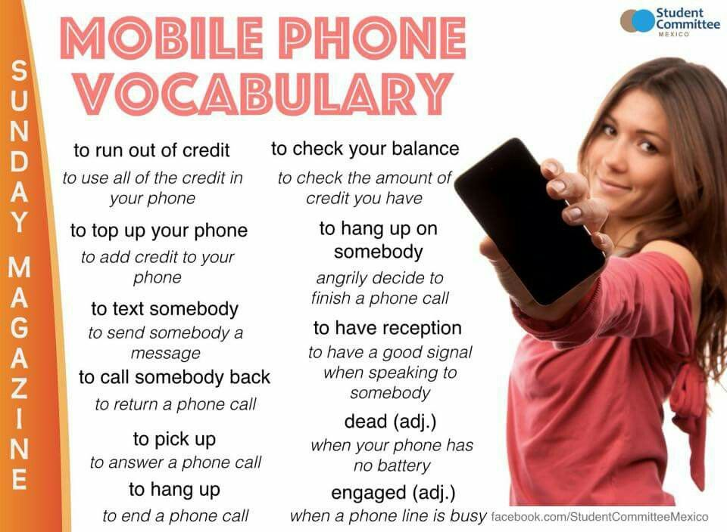
16. Smart Phones

Slide 6
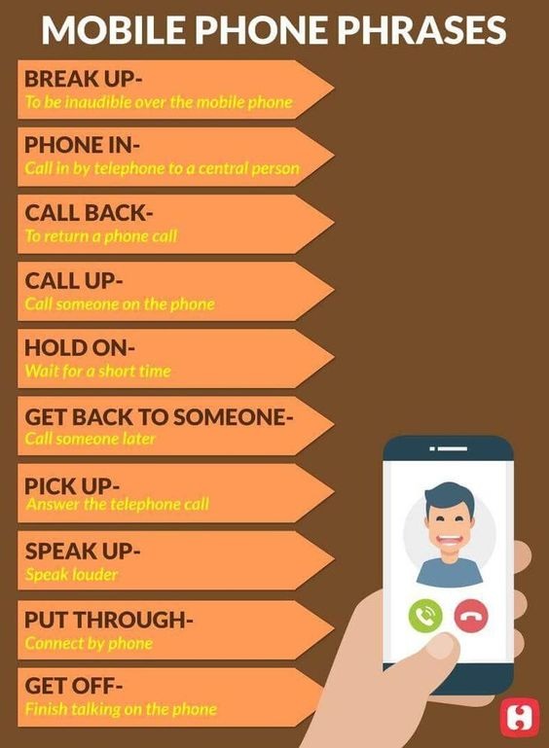
16. Smart Phones
Vocabulary:
A smart phone is a mobile phone that performs many of the functions of a computer, typically having a touchscreen interface, Internet access, camera, and an operating system capable of running downloaded apps (programs downloaded from the Apple iStore or Google Play).
Power Button (to turn on and off)
Home Button (used to unlock)
Volume Controls – Up and Down
Sound Off Switch
Settings

Slide 7
16. Smart Phones
Vocabulary:
WiFi – wireless networking
Bluetooth – for wireless connection to other devices nearby such as headphones.
Cellular Data – accessing the Internet over the mobile network
Keyboards (English, Emoji, Japanese, Chinese, Thai, etc….), Shift, Cap Locks
Icons – colorful symbols representing apps
Vibrate – a quieter way of being alerted to a call or message notifications
Flight mode – turn off mobile data and wifi connection so the phone stops transmitting and receiving signal.
Home screen – what you see when you unlock your phone
Ring Tone, Alert Tone …. the different sounds used to alert the user of an event.

Slide 8
16. Smart Phones
Idioms:
Idioms
“phone someone” = call someone “Why don’t you phone him and see if he’s coming to the party?“
“call it a day” = finish work and leave your workplace “Let’s call it a day. We can finish this project tomorrow.”
“:be ringing off the hook”
“ringing off the hook”: so many people are trying to call you that it is ringing all the time.
‘blow up (one's) phone’:
to call someone repeatedly and/or send someone a lot of text messages.
.

